Slide 1
IBM HR Attrition Data
DSC 424 : Project Presentation
Team : DATA CREW
Data set : IBM HR Analytics Employee Attrition & Performance | Kaggle
Members : Jiten Mishra , Erik Pak , Denvir Gama , Zachary Hollis

Slide 2
Overview
Attrition is a problem that impacts all businesses, irrespective of geography, industry and size of the company. Employee attrition leads to significant costs for a business, including the cost of business disruption, hiring new staff and training new staff. As such, there is great business interest in understanding the drivers of and minimizing staff attrition.
The goal is to analyze the predictive modelling capabilities and see if we can understand various factors affecting employee attrition on this IBM dataset using different analysis techniques.

Slide 3
Data Description
The Dataset consists of 35 columns.
We Identified 8 Categorical, 8 Ordinals and rest all numeric.
"age”: Age | "HrRate": Hourly Rate | "PerfRate": Performance Rate
"Attr" : Attrition [Yes/No] | "JobInvl": Job Involvement | "RelnSat": Relationship Satisfaction
"BusTrvl" : Business Travel | "JobLvl": Job Level | "StkOpLvl": Stock Option Level
"DlyRate" : Daily Rate | "JobRole": Job Role | "TotWrkYr": Total Work Hours
"Dept": Department | "JobSat": Job Satisfaction | "TrnTimeLastYr": Training Time Last Year
"DistFrmHm" : Distance from Home | "MrgStatus": Marital Status | "WrkLifeBal": Work Life Balance
"Edu" : Education | "MonthRate": Monthly Rate | "YrsAtComp": Years at company
"EduField": Education Field | "NumCompWrk": No.of Company worked | "YrsInCurRole": Years in Current Role
"EnvSat": Environment Satisfaction | "OverTime": Over Time | "YrsLstProm": Years Last Promotion
"Gender": Gender [Male/Female] | "PercSalHike": Percentage Salary Hike | "YrsCurMngr": Years Current Manager
"EmployeeNumber": Employee Number | "Over18" : Age of Employee over 18 | "MonthInc": Monthly Income
"EmployeeCount" : Total Employee | "StandardHours": Total Fixed Hours

Slide 4
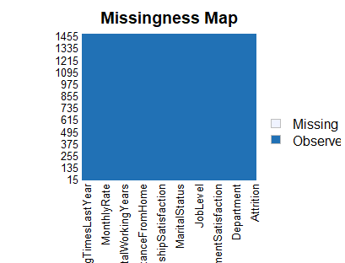
Data Transformation and Cleaning
Discarded variables of employee count, employee number, over 18 and standard hours.
Created dummies for categorical variables for regression analysis.
Performed a log transformation on Monthly Income.
We checked if there were any NA's or missing value in the data and luckily we don't have any.

Slide 5
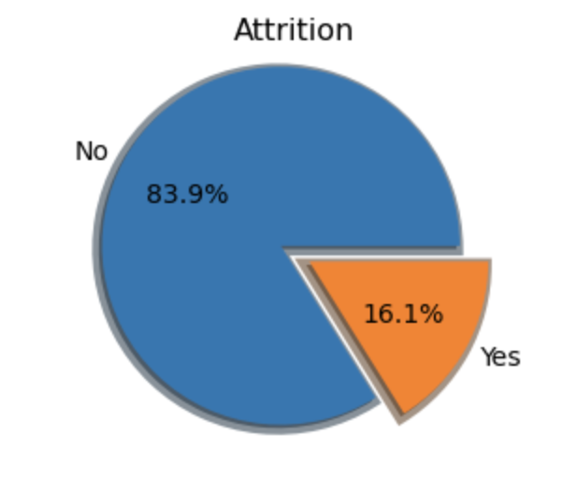
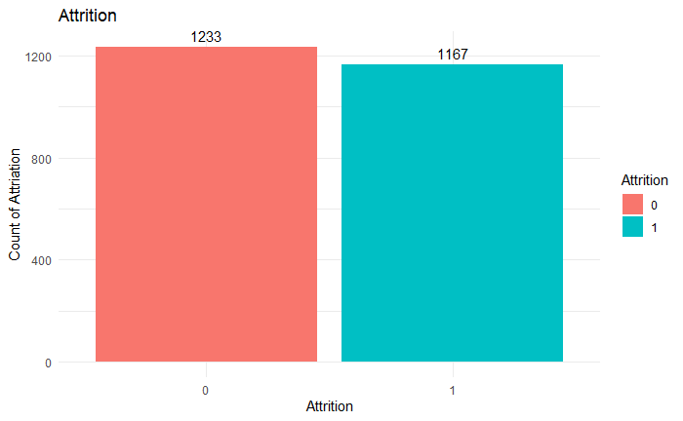
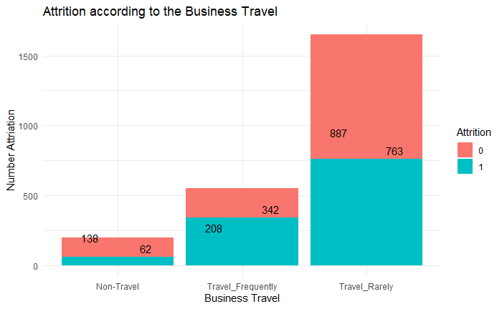
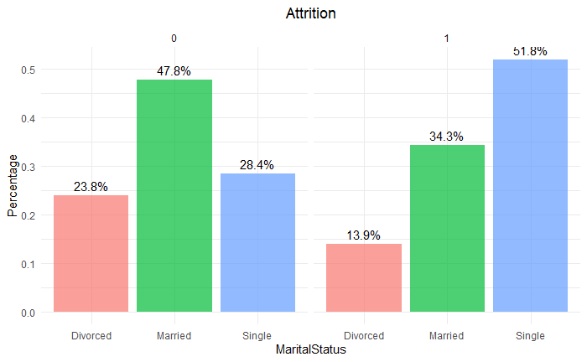
Data Visualization
As we see class imbalance we oversampled the data and the distribution is same.

Slide 6
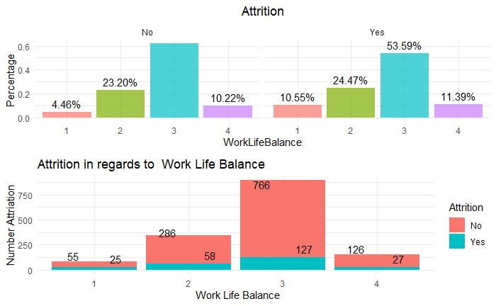
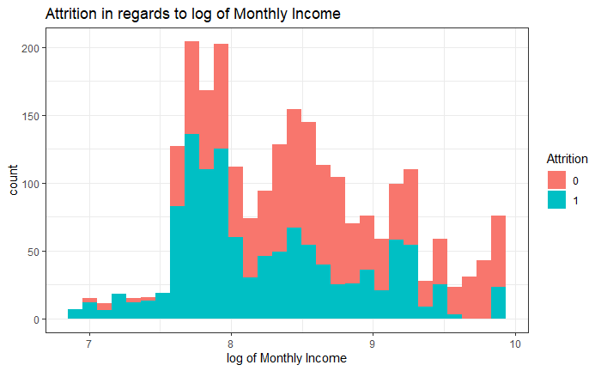
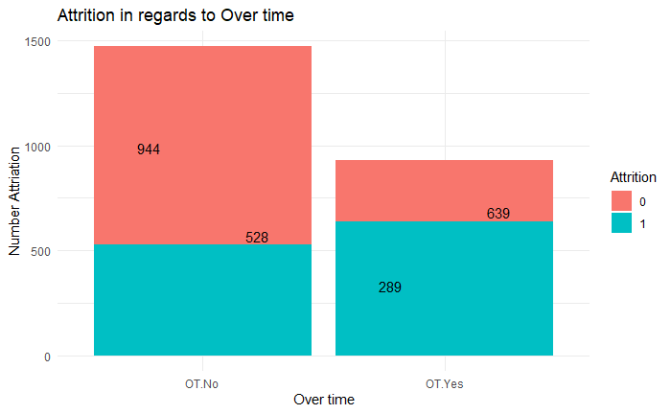
Visualization continued..

Slide 7
Lines of Analysis
In order to proceed with our analysis we performed the below lines of analysis to infer the data and reach a consensus at the end.
Principal Factor Analysis.
Multiple Correspondence Analysis.*
Regression Technique with Categorical response variable.
Linear Discriminant Analysis.
Notes:
*Opportunity for Extra credit .

Slide 8
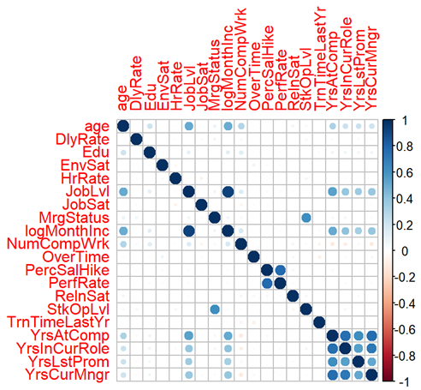
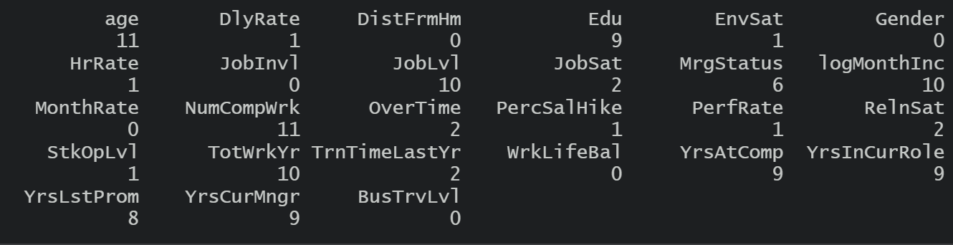
1st Line of Analysis - Principal Factor Analysis
Remove categoricals that could not be converted
Perform Initial Cor Test
Removed variables with no correlation
DistFrmHm,Gender, JobInvl, MonthRate, TotWrkYr, WrkLifeBal, BusTrvLvl

Slide 9
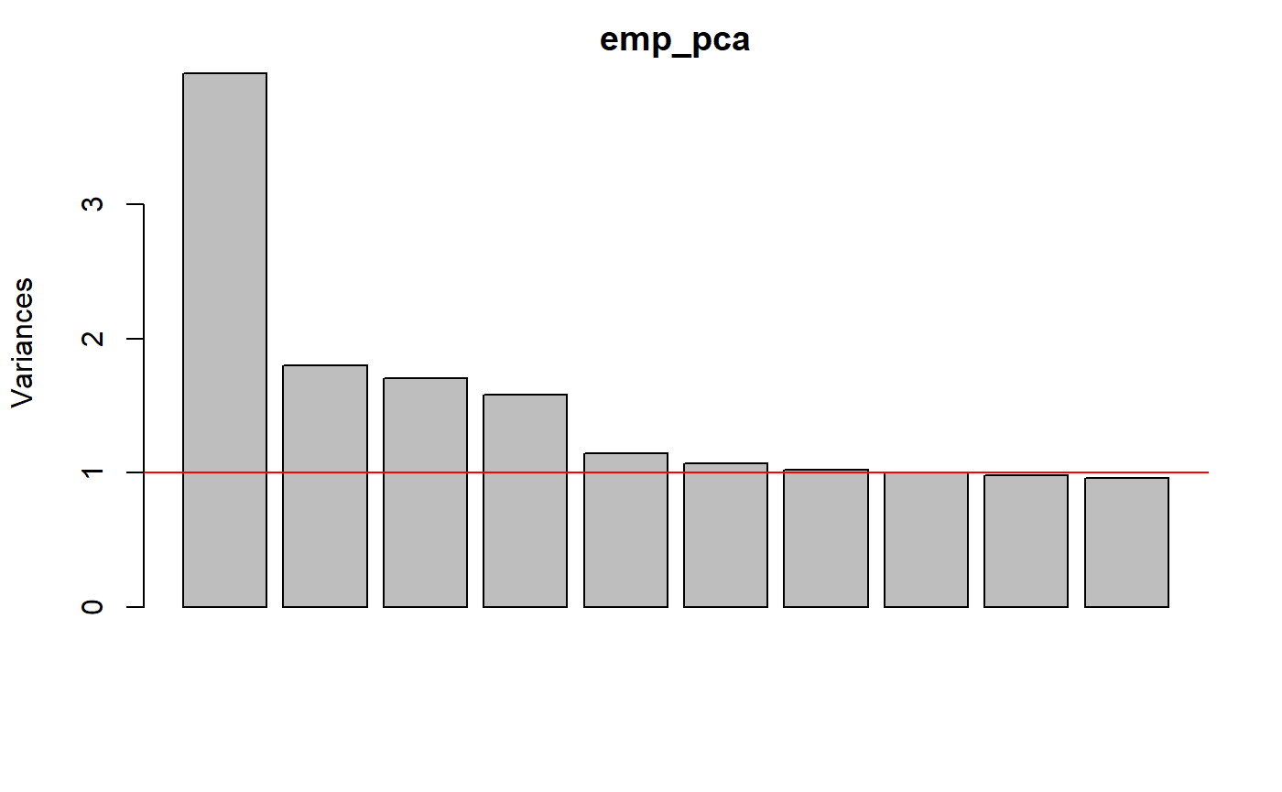
Principal Factor Analysis - PCA
Initial PCA to see how many factors we should have
V=1 suggests 7
Scree plot does not have a clearly defined knee
Potentially 4 or 5 factors

Slide 10
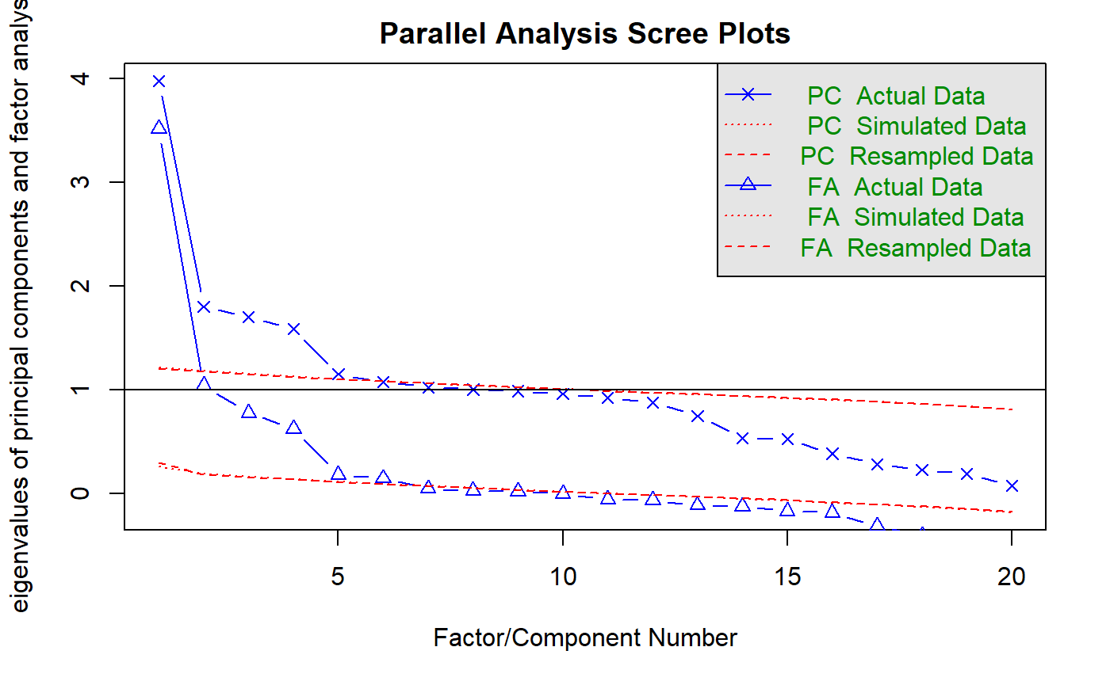
Parallel Analysis
Parallel analysis suggests that the number of factors = 6 and the number of components = 5
The best number of factors will likely be 6 or 7 judging by the PCA and the Parallel analysis

Slide 11
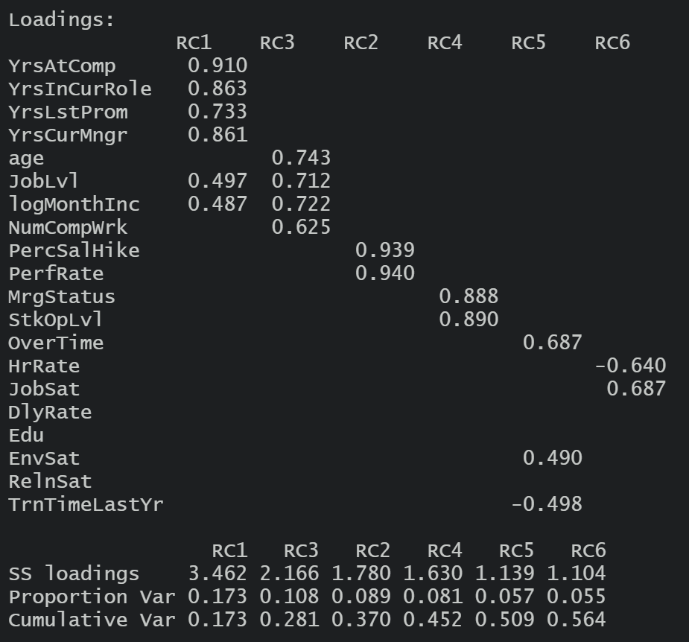
PFA using 5 and 6 factors
Conducted using the Principal function and varimax rotation
First analysis was using 5 factors
Did not create good factors
Second was using 6
Better but still the same issues

Slide 12
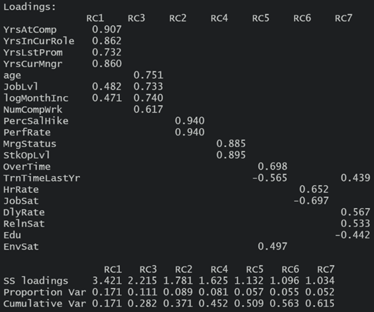
PFA - 7 factors
7 factors gave the best result
Factors could be interpreted
Did not leave out any variables
Cumulative Variance was 61%

Slide 13
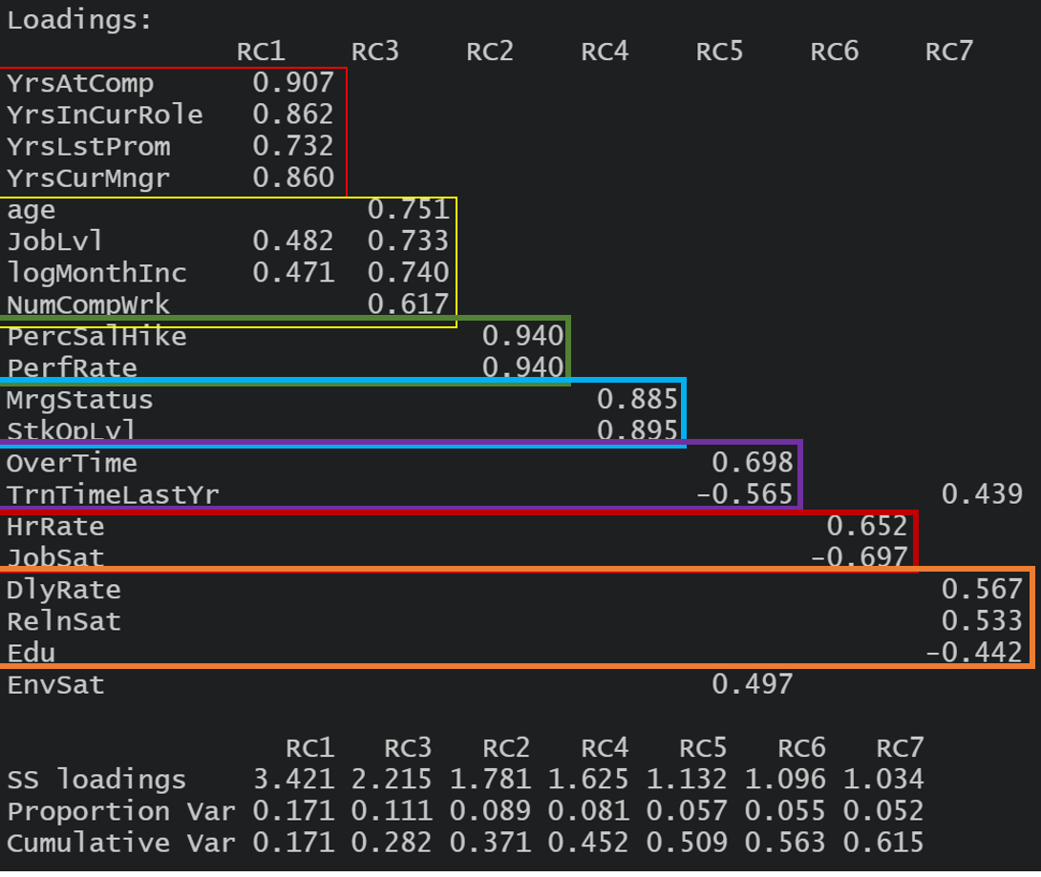
Factor interpretations
RC1 - Time with Company
RC3 - Seniority
RC2 - Performance
RC4 - Mariage/Stock
RC5 - Overtime and Training
RC6 - Hr Rate and Satisfaction
RC7 - Education, Day Rate and Relationship Status

Slide 14
2nd Line of Analysis Multiple Correspondence Analysis (MCA)
MCA is specifically designed for analyzing categorical data. It handles variables with multiple categories and aims to uncover the underlying structure and relationships between categorical variables.
Operates on contingency tables that represent the co-occurrence patterns and associations between categories of categorical variables
Represents the data in a low-dimensional space where individuals and categories are positioned based on their relationships.
Capturing the associations and dependencies between categorical variables

Slide 15

MCA Continued..
In R
MCA() (FactoMineR)
mca() (MASS)
dudi.acm() (ade4)
mjca() (ca)
homals() (homals)
http://www.gastonsanchez.com/visually-enforced/how-to/2012/10/13/MCA-in-R/

Slide 16
MCA Continued..
MCA() (FactoMineR): method parameter
Burt Method: The Burt method is generally suitable for datasets with categorical variables that have multiple categories. It can capture complex relationships and dependencies between categories, making it useful for analyzing datasets with many categories and investigating co-occurrence patterns.
Indicator Method: The Indicator method is well-suited for datasets with binary categorical variables or situations where the focus is on presence or absence patterns. It is particularly useful when dealing with binary variables or analyzing data where the presence or absence of specific categories is of interest.

Slide 17
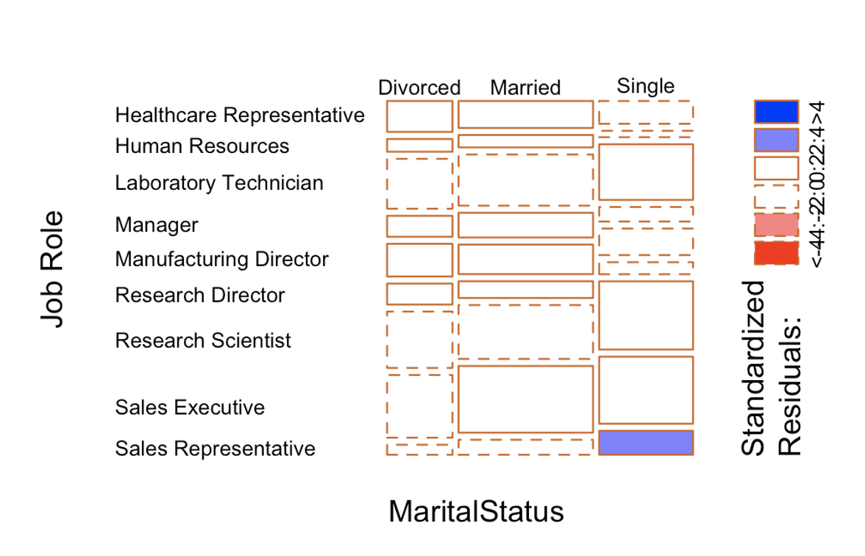
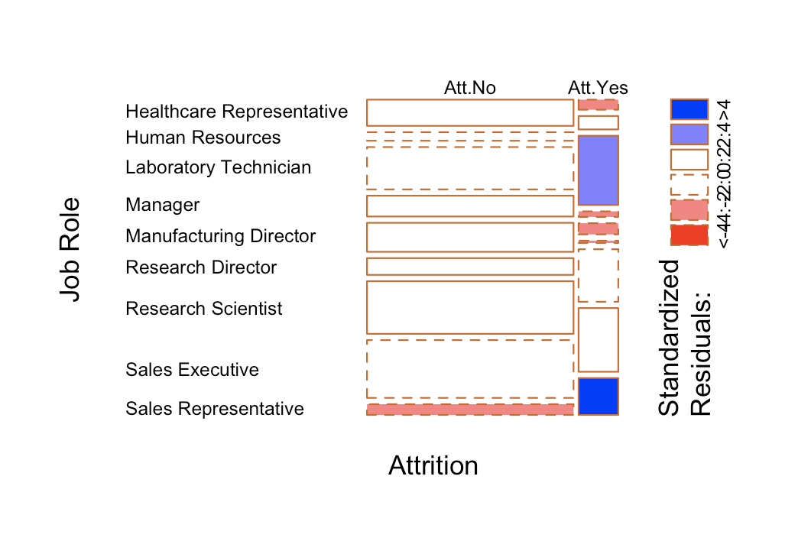
MCA Continued..
Mosaic Plot to determine the relationships between Marital Status & Attrition to the Job Role

Slide 18
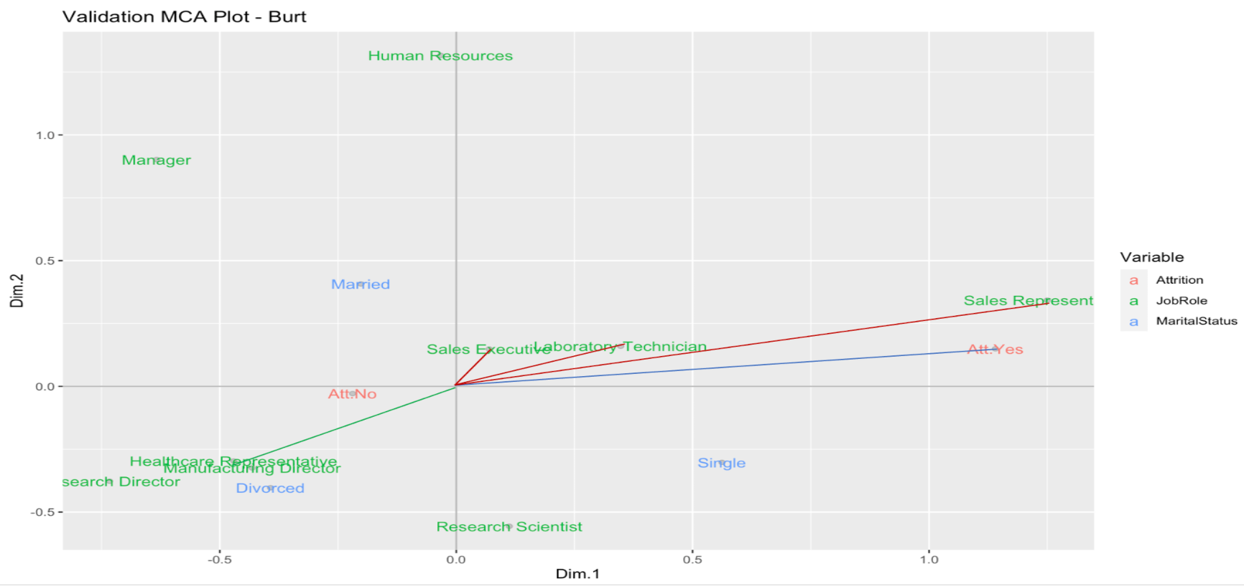
Smaller the angle, higher the correspondence

Slide 19
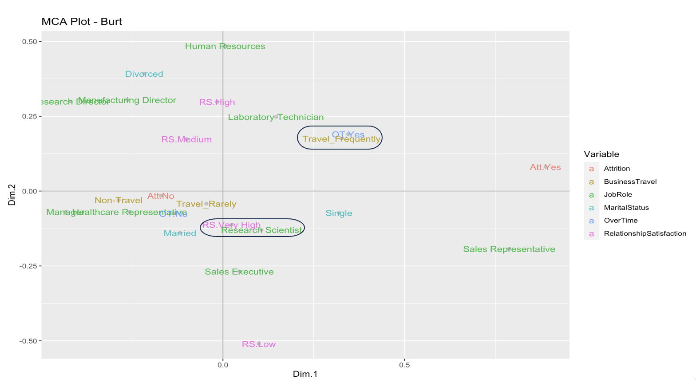
Closer the proximity, it reflects the similarity

Slide 20
Conclusion of MCA
MCA interpretation
Dimensionality reduction for categorical variables
Insights into the relationships and structures within categorical data
Visually represents the relationships among categorical variables in a low-dimensional space
As we can see Travel Frequently, Single, Over Time, and in Sales are some of the features that share similarity with attrition
A college education, either divorced or married, an upper job band have similar characteristics to those who do not experience attrition

Slide 21
3rd Line of Analysis ( Regression )
Techniques used in the Regression analysis.
Logistic
Regsubset
Ridge
Lasso
Eslasticnet
Response variable : Attrition (Categorical)
In order to perform the above techniques we had to perform some additional preprocessing of data.
Converted categorical data as factors and created dummies.
Monthly Income as a column was log transformed.
Because of class imbalance the data was oversampled for our analysis.
Since we are using full set of data for regression we performed PCA and PFA again on this set of data to get necessary factors.

Slide 22
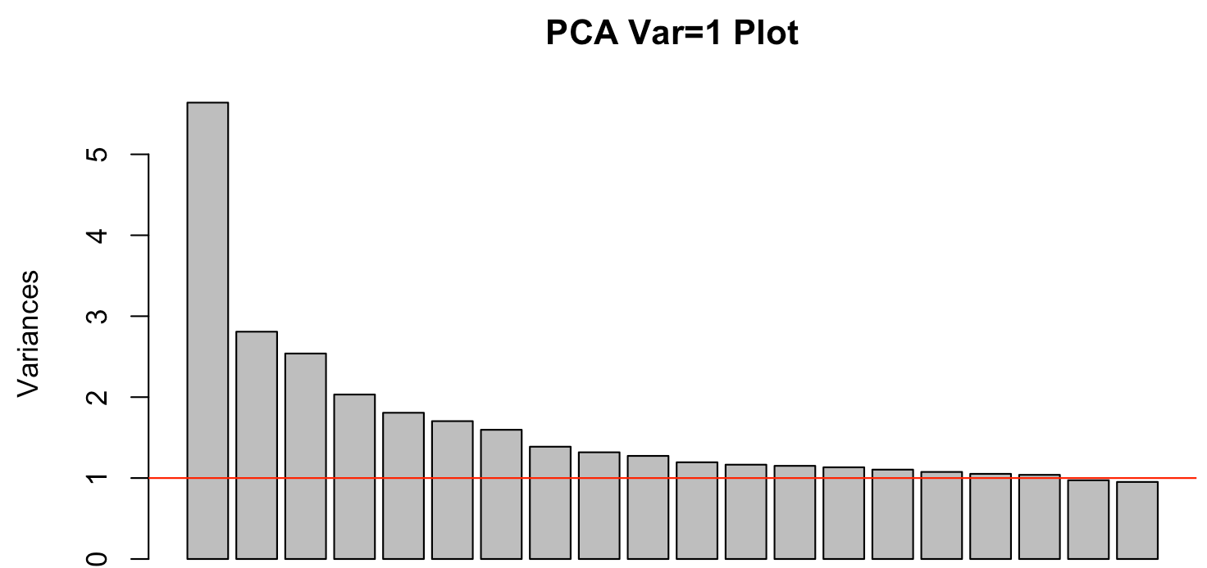
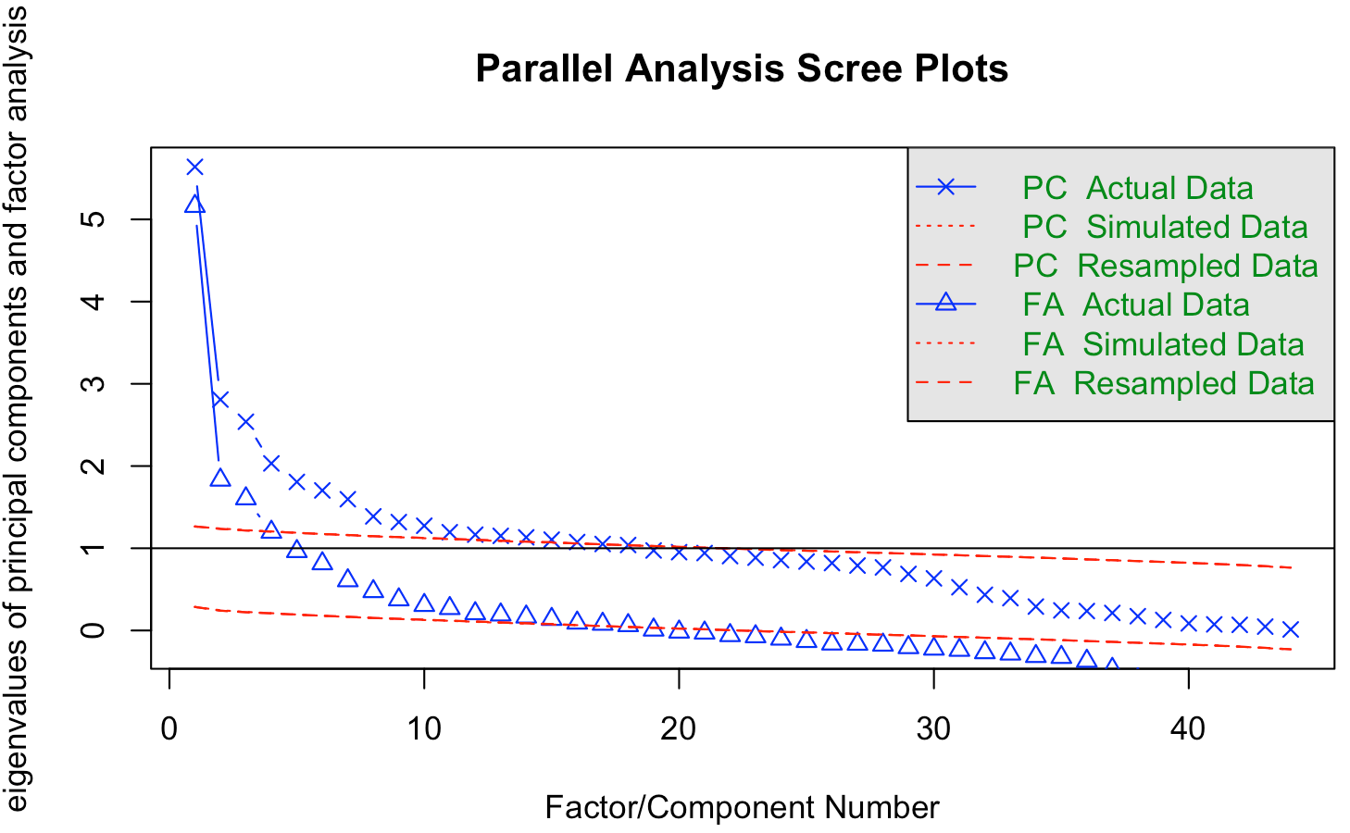
PCA for regression
As we want to see the effect of all variables in regression we converted all categorical variables to dummies and performed a PCA to identify the components.
The analysis suggests to have 18 factors but we took 13 factors which covered 58% of the variance.

Slide 23
PFA for regression
13 factors were interpreted as below.
Some of the factors were surprising to us like RC4 , RC9 which had to be analyzed how they affect the regression analysis.
RC1 = Total Experience RC2 = HR Profile RC3 = Sales and Marketing People RC4 = Marriage with StockOptions RC5 = Performance RC6 = Manager Profile RC7 = Science Education Field | RC8 = Research scientist doing overTime RC9 = LabTechnician with Gender RC10 = TechDesigner away from home RC11 = Education of a Manager RC12 = Satisfaction with Hourly Rate RC13 = Travel Profile

Slide 24
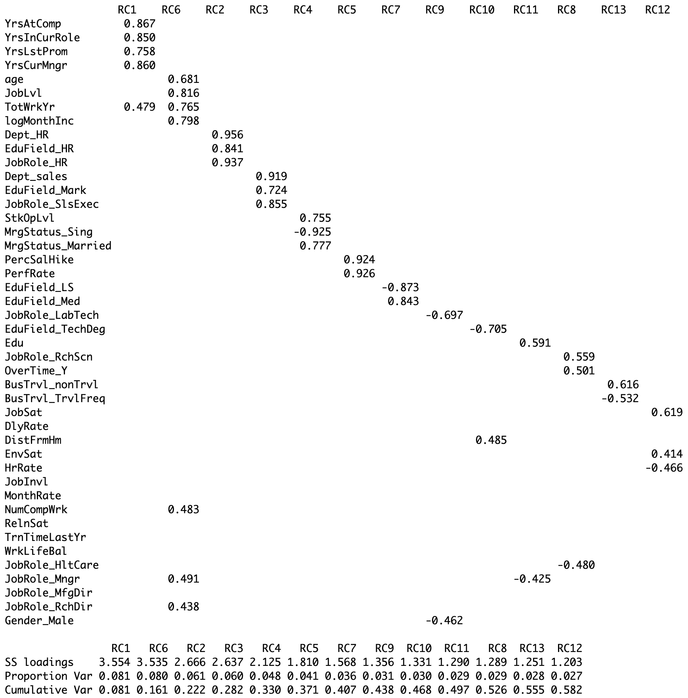
PFA Continued..

Slide 25
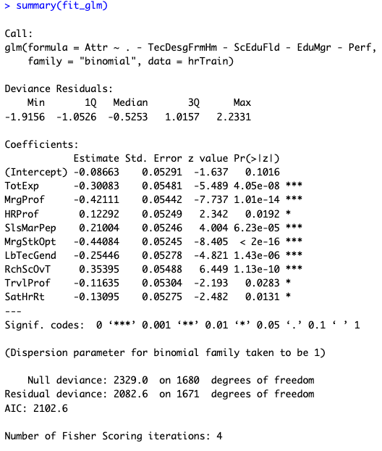
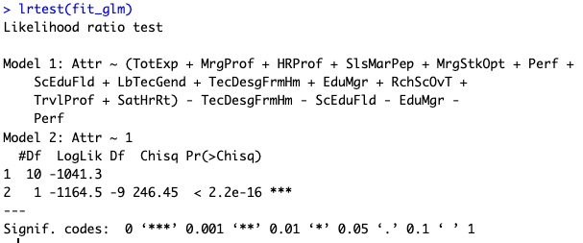
Logistic Regression
We performed a logistic regression dividing data into 70% training and 30% testing with manual variable selection and measured the performance.
The model turned out decent with selected variable being significant at p < 0.05 having a goodness of fit of chi square = 16.73 , p < 2.2e-16 ***.
Model Equation : log(p/(1-p)) = -0.08 - 0.42(MrgProf) -0.30(TotExp) + 0.21(SlsMarPep) + 0.12(HRProf) - 0.44(MrgStkOpt) - 0.25(LbTecGend) + 0.35(RchScOvT) - 0.11(TrvlProf) - 0.13(SatHrRt)

Slide 26
Performance of logistic regression
Since the data was was balanced with oversampling the threshold was set at 0.5 to measure performance.
No significant difference to indicate overfitting.
Training model | Sensitivity | Accuracy | Precision | Specificity | Recall
LogisticTrain | 0.69 | 0.68 | 0.67 | 0.68 | 0.69
Testing model | Sensitivity | Accuracy | Precision | Specificity | Recall
LogisticTest | 0.73 | 0.70 | 0.67 | 0.66 | 0.73

Slide 27
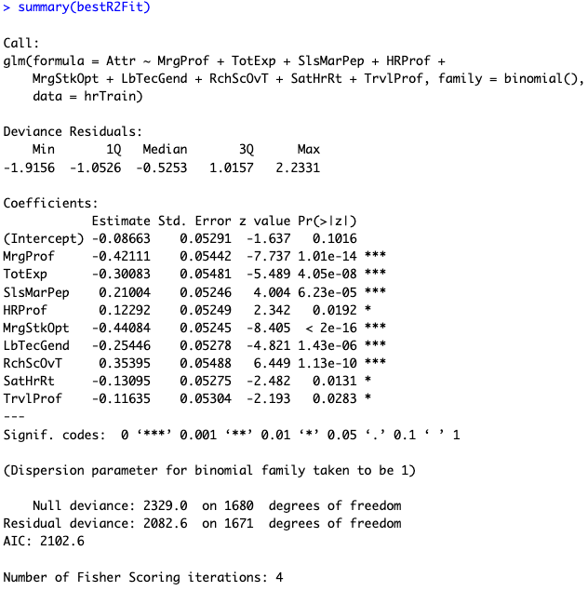
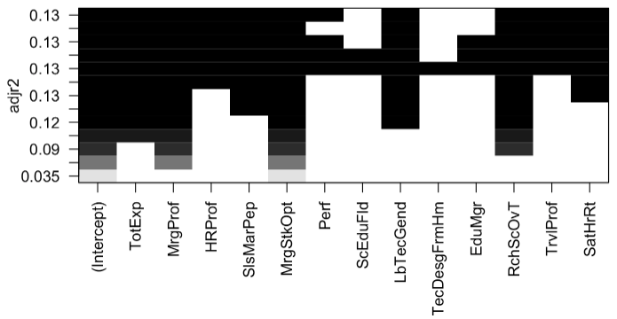
Regsubset Regression
We performed a Regsubset regression using “adjR2” and “bic” scale to measure the performance and found out the model with adjR2 did better after removing the non-significant variables and the performance was same as logistic regression.

Slide 28
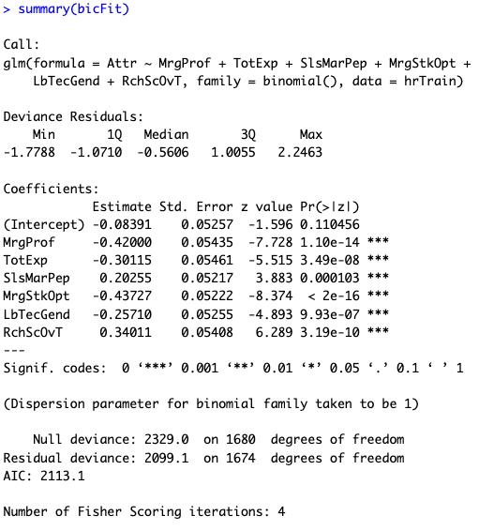
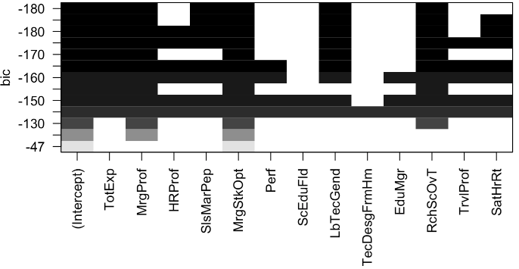
Regsubset continued..
bic scale

Slide 29
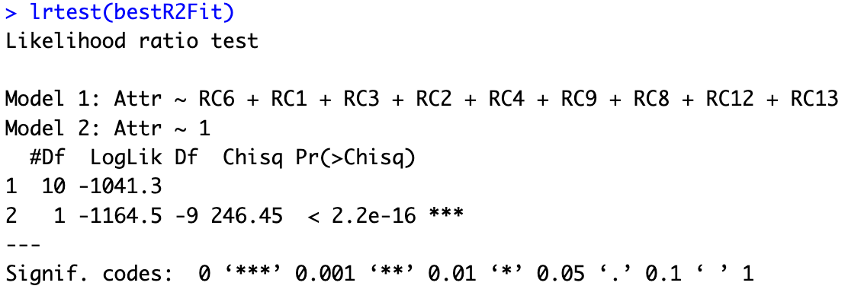
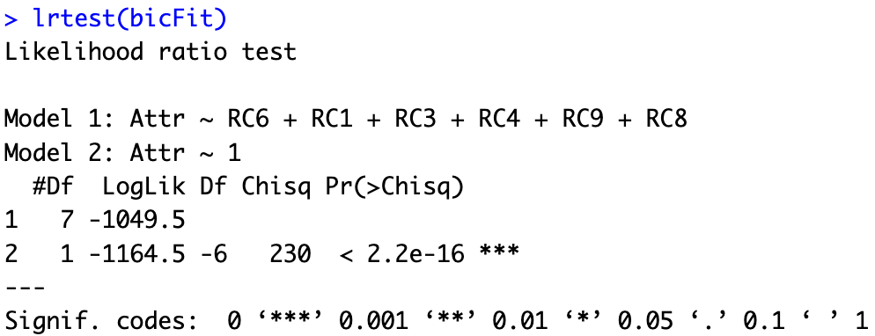
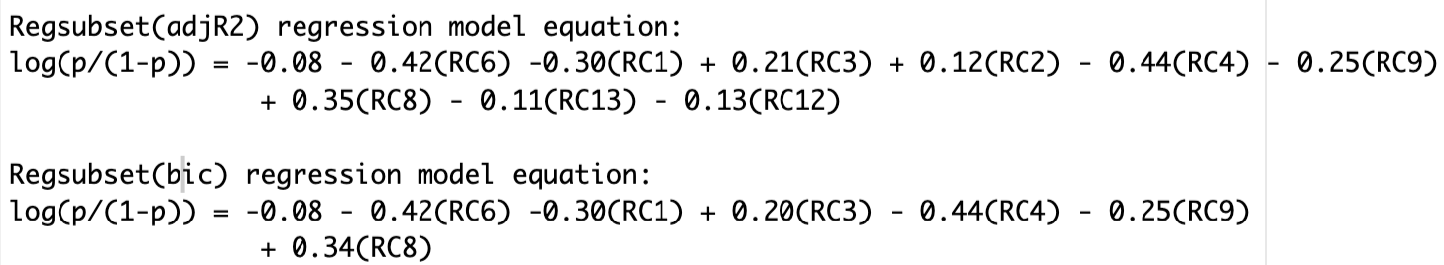
Regsubset continued..
Goodness of fit for adjR2 and bic model

Slide 30
Regsubset Performance
The threshold was set at 0.5 to measure performance.
adjR2 model turned out good here.
No significant difference to indicate overfitting.
Training model | Sensitivity | Accuracy | Precision | Specificity | Recall
RegSubsetTrain_adjr2 | 0.69 | 0.69 | 0.67 | 0.68 | 0.69
RegSubsetTrain_bic | 0.67 | 0.68 | 0.67 | 0.69 | 0.67
Testing model
RegSubsetTest_adjr2 | 0.73 | 0.70 | 0.67 | 0.66 | 0.73
RegSubsetTest_bic | 0.71 | 0.69 | 0.67 | 0.67 | 0.71

Slide 31
Ridge Regression
We performed ridge regression as another technique to verified the performance.
We select lambda.min for our lambda parameter as we want to have maximum confidence interval to capture most of the true positives.
Ridge Equation :
log(p/(1-p)) = - 0.082 - 0.39(MrgProf) - 0.27(TotExp) + 0.20(SlsMarPep) + 0.12(HRProf) - 0.41(MrgStkOpt) - 0.05(Perf) + 0.03(ScEduFld) - 0.23(LbTecGend) + 0.32(RchScOvT) - 0.04(EduMgr) - 0.01(TecDesgFrmHm) - 0.11(SatHrRt) - 0.10(TrvlProf)

Slide 32
Performance of Ridge Regression
The threshold was set at 0.5 to measure performance.
No significant difference to indicate overfitting.
Training model | Sensitivity | Accuracy | Precision | Specificity | Recall
RidgeTrain | 0.68 | 0.68 | 0.67 | 0.68 | 0.68
Testing model
RidgeTest | 0.73 | 0.69 | 0.66 | 0.65 | 0.73

Slide 33
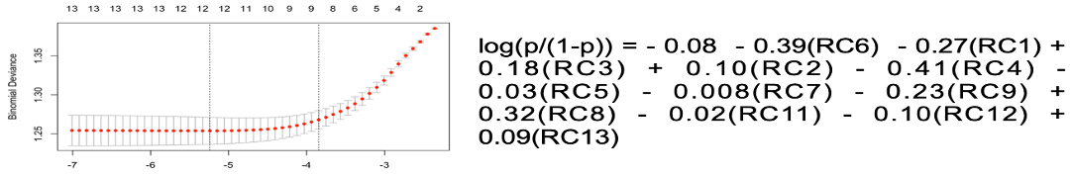
Lasso Regression
We performed a lasso regression to verify the performance again and it performed almost similar.
We select lambda.min for our lambda parameter as we want to have maximum confidence interval to capture most of the true positives.

Slide 34
Performance of Lasso Regression
The threshold was set at 0.5 to measure performance.
No significant difference to indicate overfitting.
Training model | Sensitivity | Accuracy | Precision | Specificity | Recall
LassoTrain | 0.69 | 0.69 | 0.67 | 0.68 | 0.69
Testing model
LassoTest | 0.74 | 0.70 | 0.67 | 0.66 | 0.74

Slide 35
Elasticnet Regression
For elasticnet we ran a for loop with a range of alpha 0 to 1 with an increment of 0.01 and captured the performance.
And it reported that model at alpha = 0.55 did better with performance which we see is same as the performance of lasso.
Performance of model
The threshold was set at 0.5 to measure the performance.
Testing model | Sensitivity | Accuracy | Precision | Specificity | Recall
Elasticnet Test | 0.74 | 0.70 | 0.67 | 0.66 | 0.74

Slide 36
Regression Model comparison
From the Performance matrix we see Lasso is doing slightly better than all other model which is also reported in elastic net with similar performance.
Model | Sensitivity | Accuracy | Precision | Specificity | F1 Score
LogisticTest | 0.73 | 0.70 | 0.67 | 0.66 | 0.70
RegSubsetTest_adjr2 | 0.73 | 0.70 | 0.67 | 0.66 | 0.70
RegSubsetTest_bic | 0.73 | 0.70 | 0.67 | 0.67 | 0.69
RidgeTest | 0.73 | 0.69 | 0.66 | 0.65 | 0.69
LassoTest | 0.74 | 0.70 | 0.67 | 0.66 | 0.70
ElasticNetTest | 0.74 | 0.70 | 0.67 | 0.66 | 0.70

Slide 37
Model interpretation and conclusion
Lasso Model Equation:
log(p/(1-p)) = - 0.08 - 0.39(RC6) - 0.27(RC1) + 0.18(RC3) + 0.10(RC2) - 0.41(RC4) - 0.03(RC5) - 0.008(RC7) - 0.23(RC9) + 0.32(RC8) - 0.02(RC11) - 0.10(RC12) + 0.09(RC13)
So, if we look at the model equation, we have some of the highest coefficients for RC8 which is a factor of Overtime With research scientist, RC3 which is factor of Sales and marketing people,RC2 which is a factor of HR Profile, RC6 affecting negatively which is a factor of Manager Profile, RC4 affecting negatively which is a factor of Marriage and stock option. These all factor has a significant influence on the attrition which is kind of supporting our initial hypothesis.

Slide 38

4th Line of Aspect Linear Discriminant Analysis
So for our Analysis we have used LDA as a classification algorithm to predict employee attrition based on the predictors.
This can assist HR professionals in identifying employees who are more likely to leave the company, enabling proactive measures to retain valuable talent

Slide 39
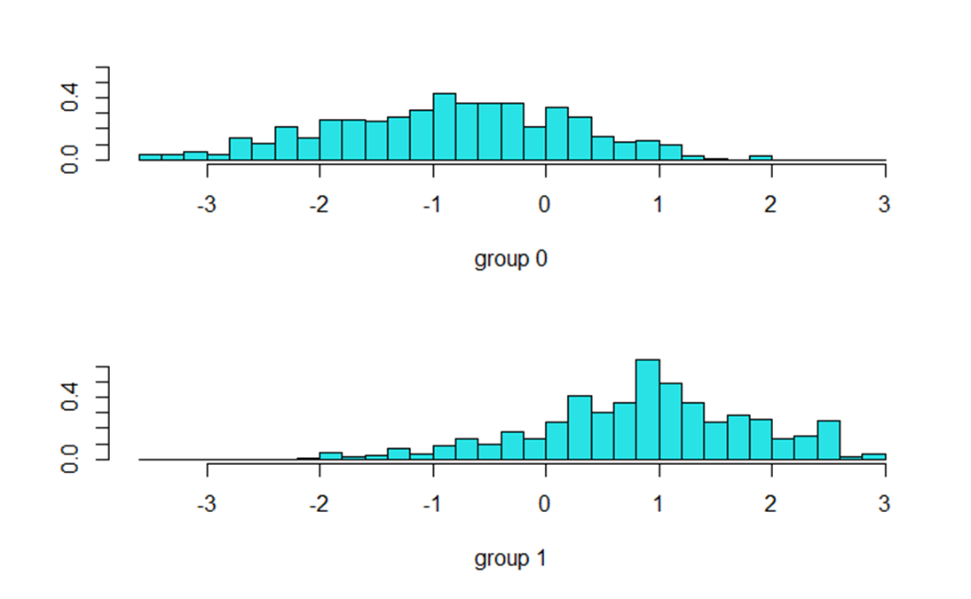
LDA Continued…
From the visualization we don't see a complete separation between the 2 categories as there are some overlaps, this maybe because of some introduction of bias during oversampling.

Slide 40
Performance of LDA in Prediction
From the confusion matrix we got a detailed breakdown of the model's predictions by showing the number of true positives, true negatives, false positives, and false negatives.
The threshold was set at 0.5 to measure the performance.
Metrics | Sensitivity | Accuracy | Precision | Specificity | Recall | F1 Score
Training | 0.84 | 0.79 | 0.78 | 0.75 | 0.84 | 0.81
Testing | 0.88 | 0.78 | 0.75 | 0.68 | 0.88 | 0.83

Slide 41
Analyzing the LD1 values from the model
OverTimeOT.Yes | 1.21
BusinessTravelTravel_Frequently | 1.05
DepartmentSales | 0.69
MaritalStatusSingle | 0.38
JobRoleLaboratoryTechnician | 0.10
Age | -0.01
Age: A decrease in age is associated with a higher LD1 value, indicating that younger employees are more likely to be associated with the discriminant function related to attrition.
BusinessTravel: "Travel_Frequently" has positive coefficients, suggesting that employees who travel frequently or rarely are more likely to be associated with the discriminant function for attrition.
OverTime: The "OT.Yes" variable (indicating employees working overtime) has a positive coefficient, indicating that employees who work overtime are more likely to be associated with the discriminant function for attrition.

Slide 42
Conclusion..
According to MCA analysis we saw Travel frequently, overtime and people in sales department with lower job level and who are single are likely to have a higher frequency of Attrition.
According to Regression people who are doing Overtime, are in sales and marketing department also people with HR Profile and people who are single are likely to have a higher frequency of Attrition.
According to LDA analysis people who do overtime, work in sales department, the singles, the ones who travel frequently and lab technicians are likely to have higher frequency of Attrition.
Summarizing the above observation we reach to a consensus that people who travel frequently, do overtime and are in lower job band and are single are prone to attrition.
And probably Companies need to take necessary steps to address/monitor these factors stringently to control attrition.

Slide 43


